Slide 1
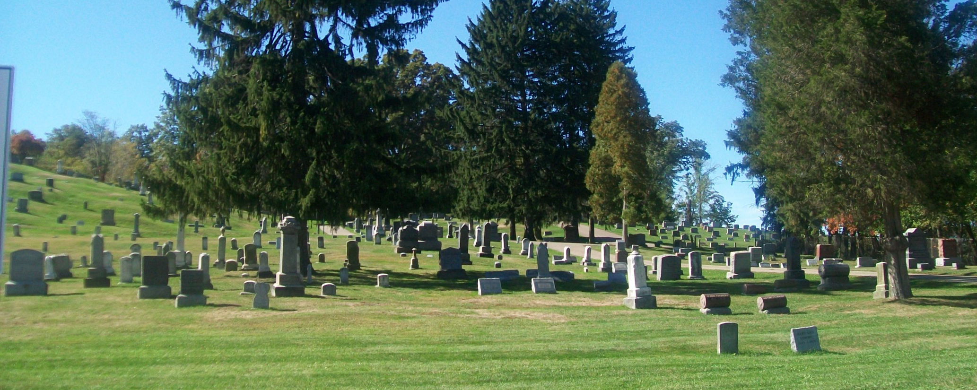
Greensburg Cemetery c. 1838
4890 Thursby Road
Notes:
HPC Public Hearing 6-21-2011
My name is Becky Witsaman. I live at 3431 Greensburg Road. I am the Historian of the Green Historical Society. I am honored to be hear tonight to describe our latest applicant for local landmark designation, Greensburg Cemetery.

Slide 2
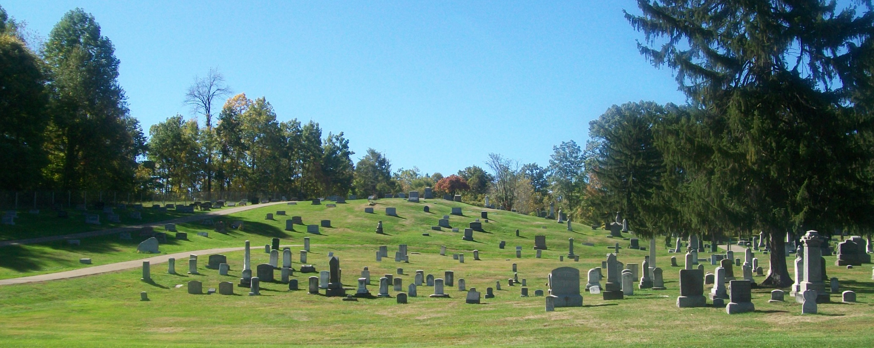
Public Hearing
Local Individual Historic Landmark
Greensburg Cemetery c. 1838
City of Green
Property Owner
Notes:
Greensburg Cemetery is located at 4890 Thursby Road.
The property owner is the City of Green.

Slide 3
Documentation of Age
3
1
2
Parcel #1 (red) – Deeded by Peter Thornton, 1838
Parcel #2 (green) – Deeded by George Cougler, 1874
Parcel #3 (blue) – Deeded by Jacob F. & Emma Boettler, 1908
Notes:
First, we will review the documentation of the age of the cemetery.
The cemetery includes three parcels in the Southeast Quarter Section of Section 28. Deed research indicates the first parcel was transfer from Peter Thorton to Adam Klinefelter, Henry Swartz, and Peter Thornton as Trustees of the Evangelical Association on November 15, 1838.
George Gougler transferred the second parcel to Trustees of Evangelical Church of Greensburgh (Greensburg) on April 1, 1874.
Jacob F. Boettler & Emma Boettler transferred the third parcel to Trustees of the Evangelical Association of North America on October 13, 1908.

Slide 4
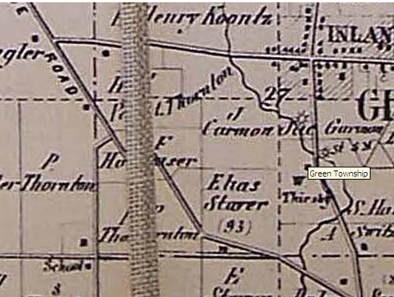
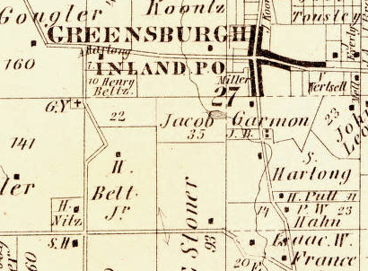
1856 Map of Summit County, published by Matthews & Taintor, map of Green Township indicating a structure at the cemetery entrance. Note at this time the cemetery was accessed via the Old Portage Road.
1874 Map and Atlas of Summit County, Map of Green Township, Tackabury, Mead & Moffet, Philadelphia 1874, indicating a “G.Y.,” graveyard, at the cemetery location. Note that by 1874 Thursby Road connects to Greensburg Road and provides access to the cemetery.
Notes:
Now, lets review the historic atlases of Summit County.
At the top of the slide, the 1856 Map of Summit County indicates a structure at cemetery entrance, which was most likely the old Evangelical Meeting House that we will discuss shortly. Note at this time the cemetery was accessed via the Old Portage Road running diagonal across Green Township.
At the bottom of the slide, the 1874 Atlas of Summit County indicates “G.Y.,” graveyard, at the cemetery location. Note that by 1874 Thursby Road connects to Greensburg Road and provides access to the cemetery. Old Portage Road no longer is shown to run diagonally through Green Township.

Slide 5
Documentation of
Historical Significance
Description of Greensburg Cemetery from the History of Summit County, Perrin, 1892, from page 606, paragraph 1:
“The Evangelical church graveyard, about one half mile west of Greensburg, was started about the year 1836. Peter Thornton states he donated the first piece of this land to the church for cemetery purposes, and that his son, George Thornton, aged about twelve, as the first person buried there. In 1875, an additional acre of land was purchased from George Gougler, and added to this cemetery. Rev. Elias Stoeber was possibly the first person buried in the new addition.”
Note that the Deed transfer from Peter Thornton to the Trustees of the Evangelical Association in 1838 states that the Trustees are “…Trustees of a certain meeting house which is about being erected…”
Notes:
Now we will look at the historical significance of the cemetery. From the History of Summit County by Perrin, 1892,
“The Evangelical church graveyard, about one half mile west of Greensburg, was started about the year 1836. Peter Thornton states he donated the first piece of this land to the church for cemetery purposes, and that his son, George Thornton, aged about twelve, as the first person buried there. In 1875, an additional acre of land was purchased from George Gougler, and added to this cemetery. Rev. Elias Stoeber was possibly the first person buried in the new addition.”
The Deed transfer from Peter Thornton to the Trustees of the Evangelical Association in 1838 states that the Trustees receiving the property are “…Trustees of a certain meeting house which is about being erected…”
Before we discuss this meeting house, I would like to briefly describe the builders of the meeting house and the events that were occurring in Greensburg and across the Midwest in 1838.

Slide 6
America & Green Township in 1838
By 1800, Pennsylvania is the breadbasket of the US
Early Immigrants to Eastern States are now searching for more farmland
Green Township is surveyed in 1805 and the first land patent holder enters the Township in 1809
By 1820, 8.8 million acres of Ohio have been sold by Federal Land Offices
Notes:
By 1800, Pennsylvania was the breadbasket of the United States. Many German families had immigrated to Pennsylvania to farm; farmland was becoming scarce, but the growing US population kept demand high. Farmers from across the East Coast began moving West in search of more farmland.
Green Township was part of the Congress Lands North of the Seven Ranges and land patents were available from the Steubenville Land Office after the 1805 survey. However, Green Township was not organized as a township until 1809 and the first land patent holder to enter the township is believed to have arrived that same year. Settlers could buy 320 acres for as little as $1.64/acre if they could pay cash. Although this was a hefty sum in the early 1800’s, land sales were swift. By 1820, Ohio’s Federal Land Offices had sold 8.8 million acres of land. Ohio was quickly shifting from a westward destination for settlers to the gateway to the rest of the West.

Slide 7
America & Green Township in 1838
Soon after first settlers arrive, Methodist and Evangelical circuit riders enter Green Township to preach to the settlers
Conrad Dillman opened his home for the first services of the Evangelical Association in Green Township
Notes:
Circuit Riders were preachers who travelled by horseback across the frontier in search of settlers eager to hear the gospel. Methodist and Evangelical circuit riders entered Green Township as early as 1816. Early settlers, Conrad & Catherine Dillman, offered their home as a meeting place for a newly formed congregation to meet as early as 1822. Circuit preachers would lead the congregation, first in the Dillmans’ log cabin and later in their newly constructed brick home, circa 1832.

Slide 8
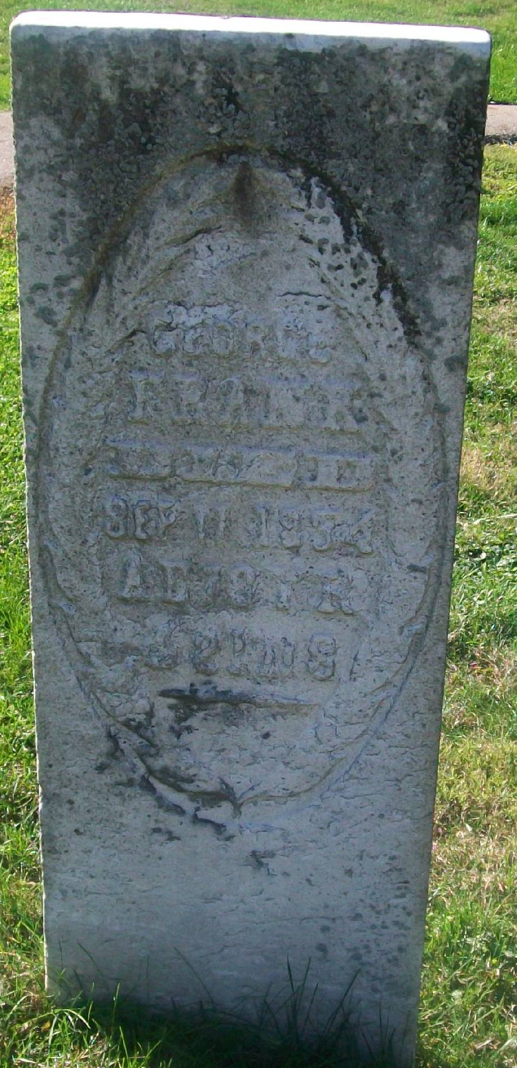
History of the Evangelical Association
Began in 1800 in Eastern Pennsylvania with the preaching of Jacob Albright
Many followers were of Pennsylvania German descent
Sermons were given in German
As members migrated across the Midwest, the Circuit Riders followed
Notes:
The Evangelical Association began in 1800 in Eastern Pennsylvania with the preaching of Jacob Albright. Jacob Albright was of German decent. Albright modeled his new faith from his experiences with the Methodists in Pennsylvania, but with the important difference that his sermons were given in German, which was generally unacceptable to the Methodists who used English exclusively in sermons. As the Evangelical Church was expanding throughout Pennsylvania, many Pennsylvanians where migrating west in search of land. Circuit Riders from Pennsylvania began entering Ohio to reach new settlers and the Pennsylvania natives already familiar with the Evangelical Church. The circuit riders returned word to Pennsylvania of the good land and devote settlers in Green Township

Slide 9
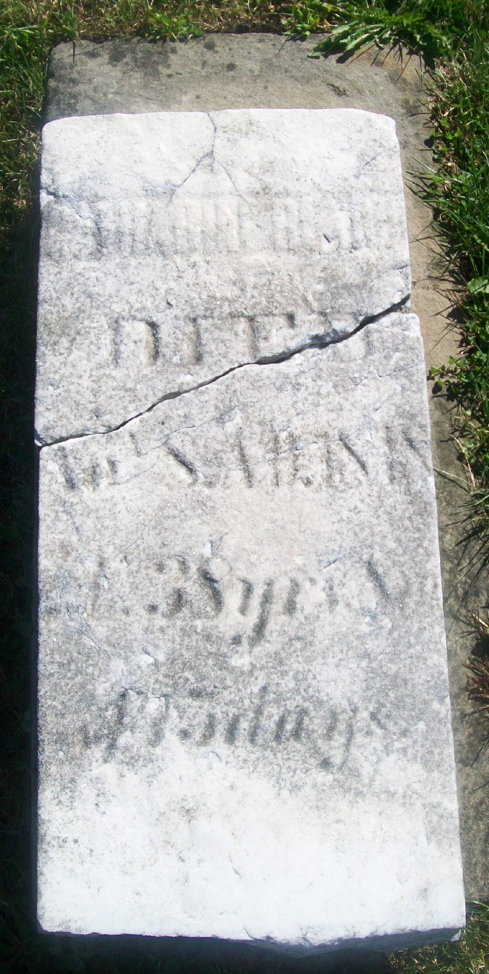
History of the Evangelical Association
Construction of the First Church West of Pennsylvania in Greensburg in 1838 makes Greensburg the hub of activity for Evangelicals and a launching point for those migrating West
Notes:
After the construction of the first church in Ohio in Greensburg in 1838, the Evangelical Association held its 1838 annual conference in the new Greensburg Emanuel Church. Preachers travelled hundreds of miles through the wilderness to attend the conference. Greensburg became a launching point for Circuit Riders and pioneers heading west.
After the construction of the first church, more Pennsylvania Germans migrated into Greensburg. By 1855, the Evangelical Church followers in Greensburg were so numerous and prosperous that they were able to establish the Greensburg Seminary, a coed, non-denominational school of higher education. Although fundamental in their faith and conservative in their preferred life style, the Evangelicals had progressive ideas about education.

Slide 10
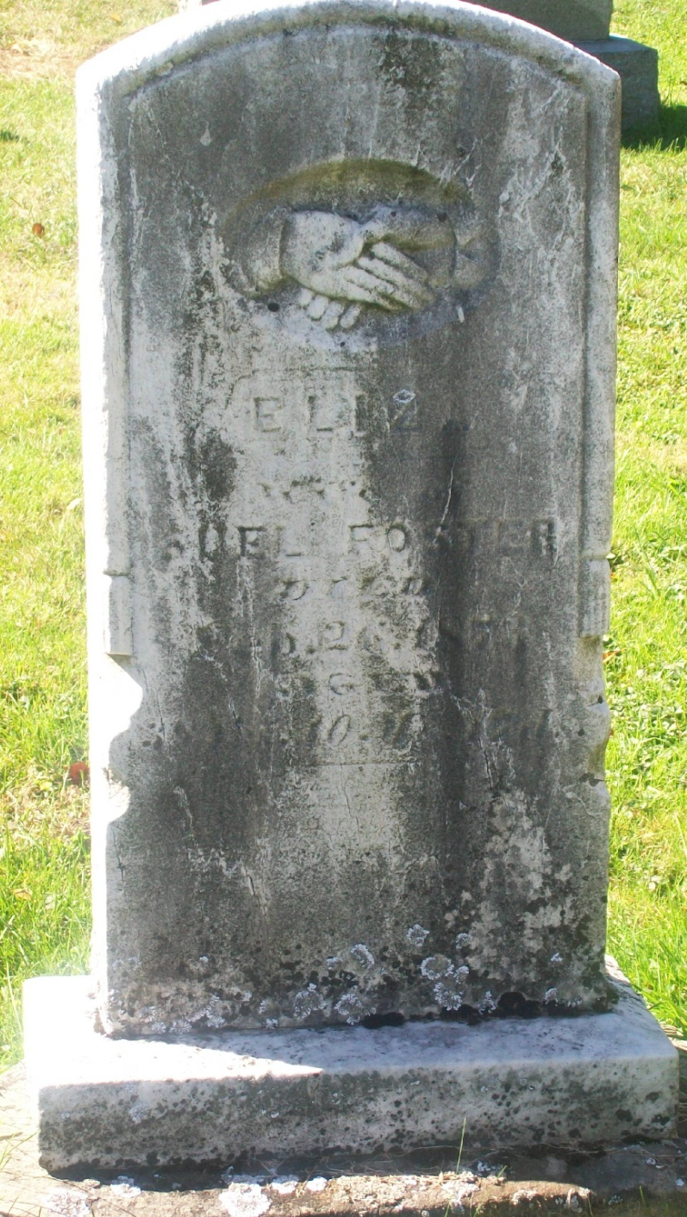
History of the Evangelical Association
The Evangelical Association became a large national and international denomination throughout the later 1800s
Merged with the United Brethren in 1946 to form the Evangelical United Brethren Church (E.U.B.)
The E.U.B. Church merged with the Methodist Episcopal Church in 1968 to form the United Methodist Church
The Greensburg United Methodist Church traces its roots to the first Evangelical Church located on the cemetery property
Notes:
During the late 1800’s the Evangelical Association became a large, successful, national denomination and Greensburg remained a loyal yet less populous Evangelical settlement. The Evangelical Association merged with the United Brethren in 1946 to form the Evangelical United Bretheran Church. The E.U.B. Church would eventual merge with the Methodist Episcopal Church in 1968 to form the United Methodist Church. The congregation of the Greensburg United Methodist Church today traces its roots to the first Evangelical Church in Ohio built on the land of the proposed designation.

Slide 11
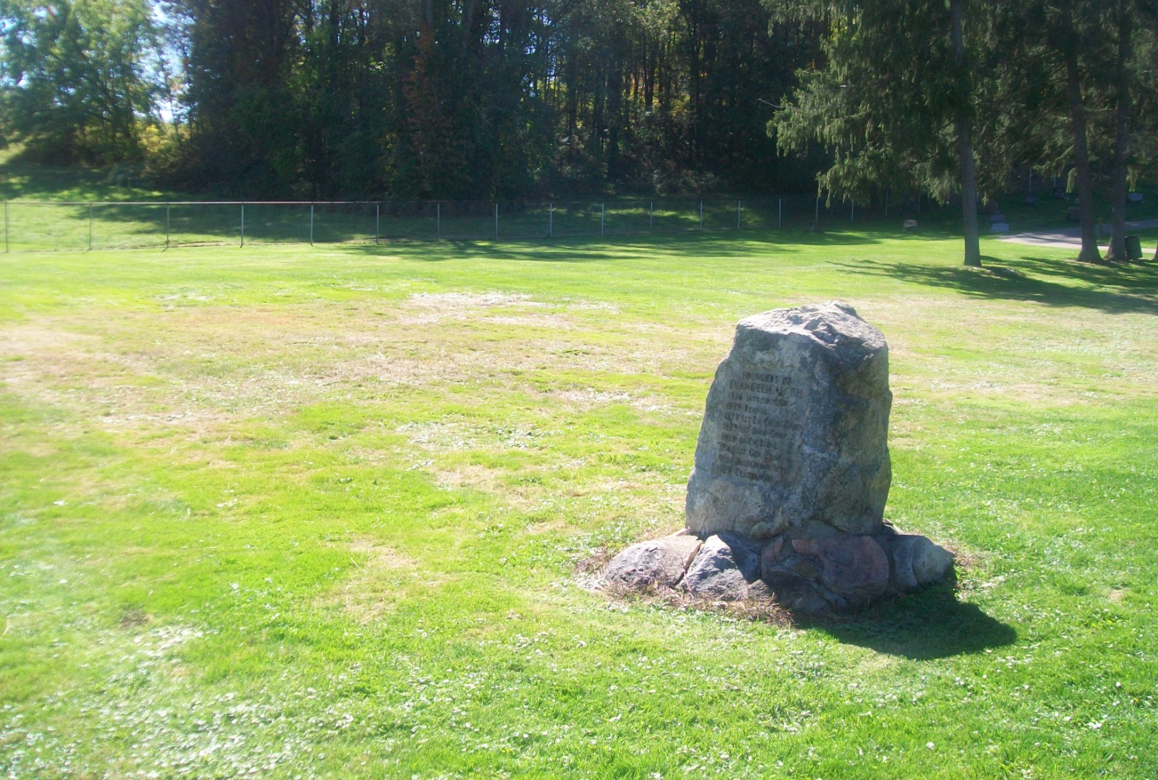
Documentation of
Historical Significance
Notes:
In 1838 a Meeting House was constructed at the front of the cemetery lot. The Church was the first Evangelical Church built in Ohio and also the first Evangelical Church built West of Pennsylvania. The church is described in The Evangelical Church in Ohio, by Roy B. Leedy, page 67 as follows,
“The site of the first Evangelical Church building was three-quarters of a mile west of the village of Greensburg. Here on the west side of the road is located a beautiful cemetery on the hillside, sloping toward the east. Between the road and the cemetery is a vacant lot where the church stood. It was a plain 28x40 “Versammlungshause” (meeting house) without Cornish and with neither tower nor bell. It faced eastward with a double door entrance in the front, a side door opening to the south, and three windows on each side.
The women entered the church from the side door and occupied the pews on the south side. They approached their pews from an aisle along the south wall of the building. The other ends of the pews were closed with a solid board petition along the middle aisle. The pews occupied by the men were fitted against the north wall so that the only entrance was from the central aisle. The men entered from the double front door and there was no intermingling of the sexes during worship services. A stove stood on each side of the room before the front pews near the side wall. There was an “amen corner” on both sides of the front part of the church – on the south for the women and on the north for the men. The rostrum was semi-circular in form; one step high with a railing used for the communion service, and the pulpit stand on a still higher platform.”

Slide 12
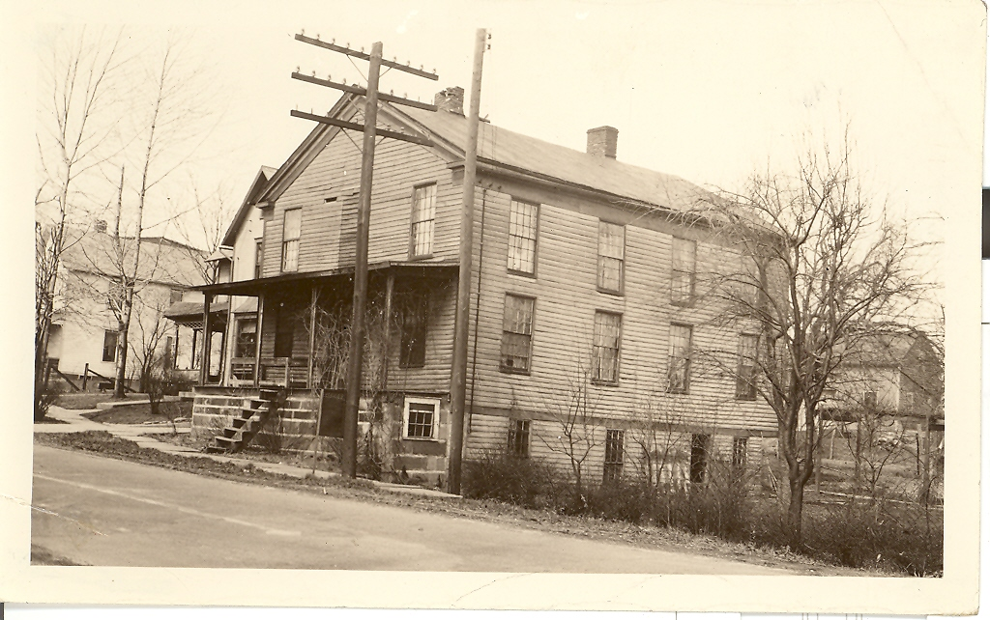
Documentation of
Historical Significance
Notes:
The old church building was moved from the lot in front of the cemetery to Greensburg in 1855 and was then used as a rooming house for students of the Greensburg Cemetery. The old church stood on the north side of the street a little east of the square and was used as a private residence until 1945 when it was replaced by a modern dwelling. This photo shows the church building after being moved into Greensburg and modified as a private residence.
In 1929 a stone marker was placed at the site of the first church on the front portion of the cemetery lot. The stone marker on the cemetery lot and the slight change in the appearance of the grass where the old church foundation was filled are the only remaining indication of the first Evangelical Church in Ohio.

Slide 13
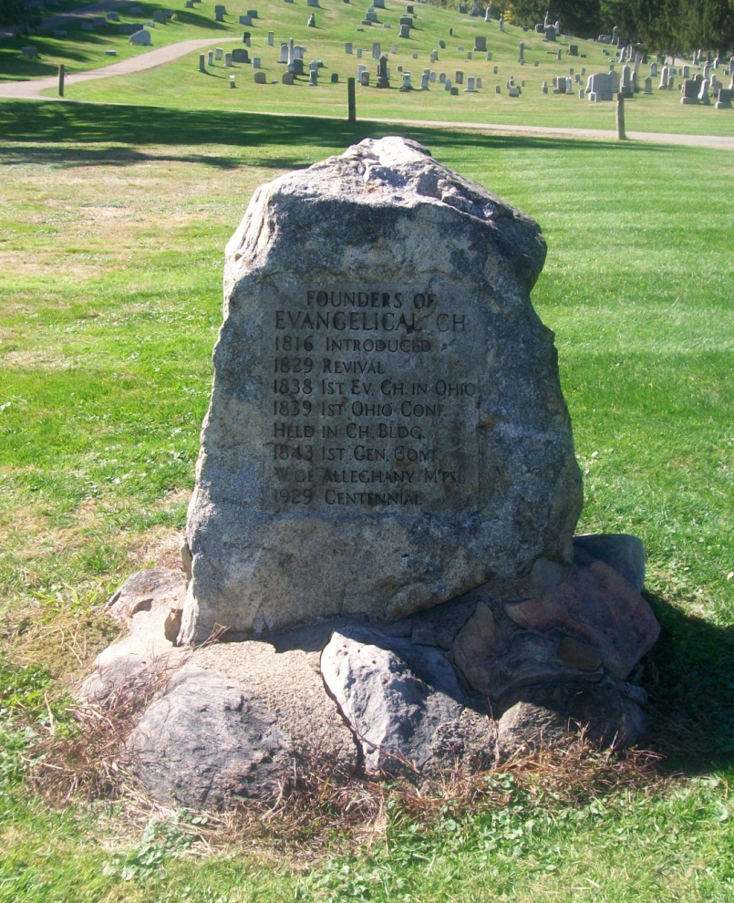
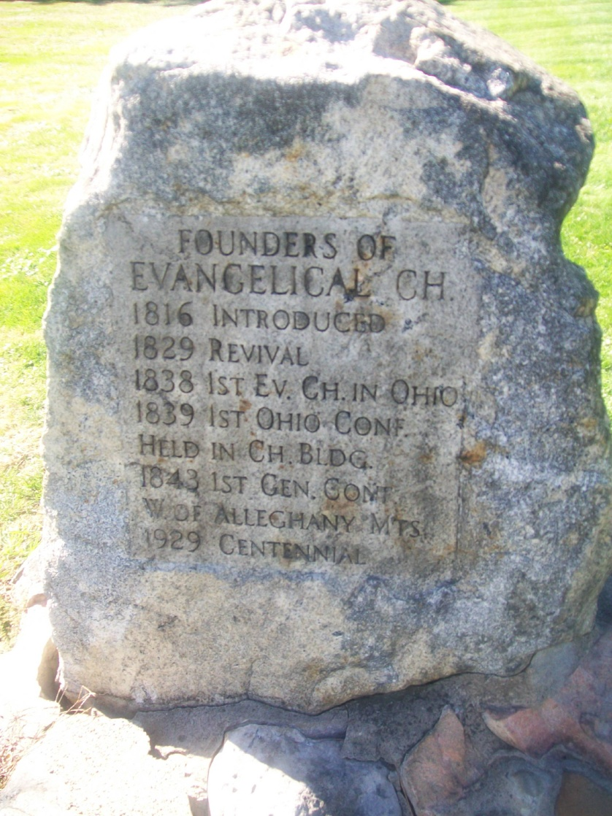
Documentation of
Historical Significance
Notes:
A marker stone was placed at the location of the First Evangelical Church by the Evangelical Association during their Centennial Celebration in 1929. According to The Evangelical Church in Ohio, by Roy B. Leedy, page 331, “A centennial and home-coming was sponsored August 6-11, 1929, under the faithful labors of Merle A. Hayes….

Slide 14
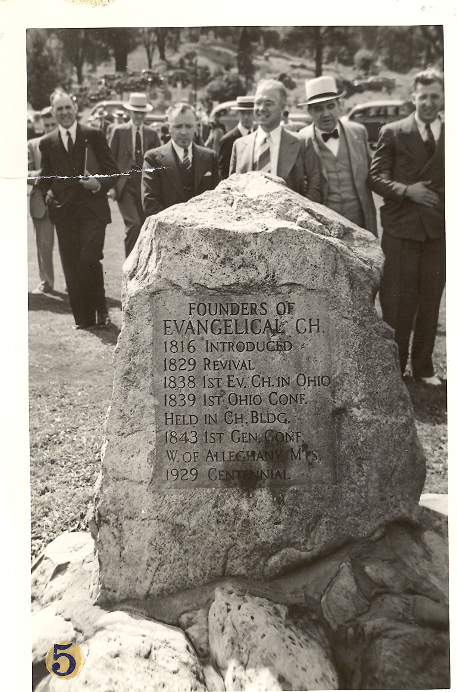
Documentation of
Historical Significance
Notes:
…. On Saturday a large congregation witnessed the unveiling of a monument erected at the site of the first Evangelical Church building in Ohio.” See pictures in Leedy pages 330-331, showing crowd gathered at Greensburg Cemetery to witness unveiling of the stone marker. Note this pilgrimage also travelled to the site of Greensburg Seminary and the Conrad Dillman home in 1929.

Slide 15
Documentation of
Historical Significance
Notes:
The stone marker on the cemetery lot and the slight change in the appearance of the grass where the old church foundation was filled are the only remaining indication of the first Evangelical Church in Ohio.

Slide 16
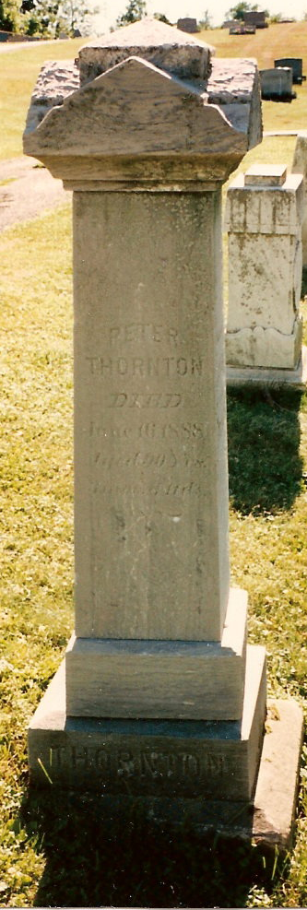
Documentation of
Historical Significance – Peter Thornton Family
Peter Thornton was born in 1798 in Pennsylvania and arrived in Greensburg in 1828. Here he lived, married and raised six children of record. In 1838, Peter Thornton donated one acre from his farm for consideration of $15.00 to the Evangelical Assoc. for the first meeting house (church) in Ohio. This one acre may have also been a burying ground for his son, see Perrin.
The Thornton, Strawhecker (Peter’s daughter Louisa was married to David Strawhecker) and Semler Families (Peter’s daughter Fannie was married to Albert Semler) are all buried in Greensburg Cemetery.
Notes:
The Greensburg Cemetery is also associated with the life and death of one of Green Townships early settlers and his family. Peter Thornton was born in 1798 in Pennsylvania and arrived in Greensburg in 1828. Here he lived, married and raised six children of record. In 1838, Peter Thornton donated one acre from his farm for consideration of $15.00 to the Evangelical Assoc. for the first meeting house (church) in Ohio. This one acre may have also been a burying ground for his son, see Perrin.
Peter’s occupation in the early census was that of a stocking weaver at the age of 72. Peter Thornton died Saturday, June 16, 1888 at 90 years, 3 months, 11 days. Peter Thornton was a long time member and supporter of the Evangelical Association. Several of his children were also members of the Greensburg Congregation of the Evangelical Association. The Thornton, Strawhecker (Peter’s daughter Louisa was married to David Strawhecker) and Semler Families (Peter’s daughter Fannie was married to Albert Semler) are all buried in Greensburg Cemetery.

Slide 17
Documentation of
Historical Significance – Veterans
Seventy (70) veterans of the wars of 1812, Mexican, Civil, Spanish, and World War I.
More veterans have been laid to rest in Greensburg Cemetery from later wars since 1979.
Notes:
According to the Cemeteries of Summit Co., OH, Vol. 2, Summit County Chapter OGS, 1979 (inscriptions) , available from Akron-Summit Public Library Special Collections, at page 72:
As of 1979, seventy (70) veterans of the wars of 1812, Mexican, Civil, Spanish, and World War I have been buried in Greensburg Cemetery. More veterans have been laid to rest in Greensburg Cemetery from later wars since 1979. This information is available from the Green Historical Society.

Slide 18

Documentation of
Architectural Significance
Burial Arrangement - The cemetery graves are positioned east/west. This orientation is common throughout the United States and throughout the world at Christian burial locations.
Notes:
Burial Arrangement - The cemetery graves are positioned east/west. This orientation is common throughout the United States and throughout the world at Christian burial locations. According to The Association for Gravestone Studies,
“(i)n many, but by no means all, early New England burying grounds the graves are positioned east/west. This east/west orientation is the most common orientation in other parts of the country and world as well. The earliest settlers had their feet pointing toward the east and the head of the coffin toward the west, ready to rise up and face the "new day" (the sun) when "the trumpet shall sound and the dead shall be raised" or when Christ would appear and they would be reborn.”

Slide 19
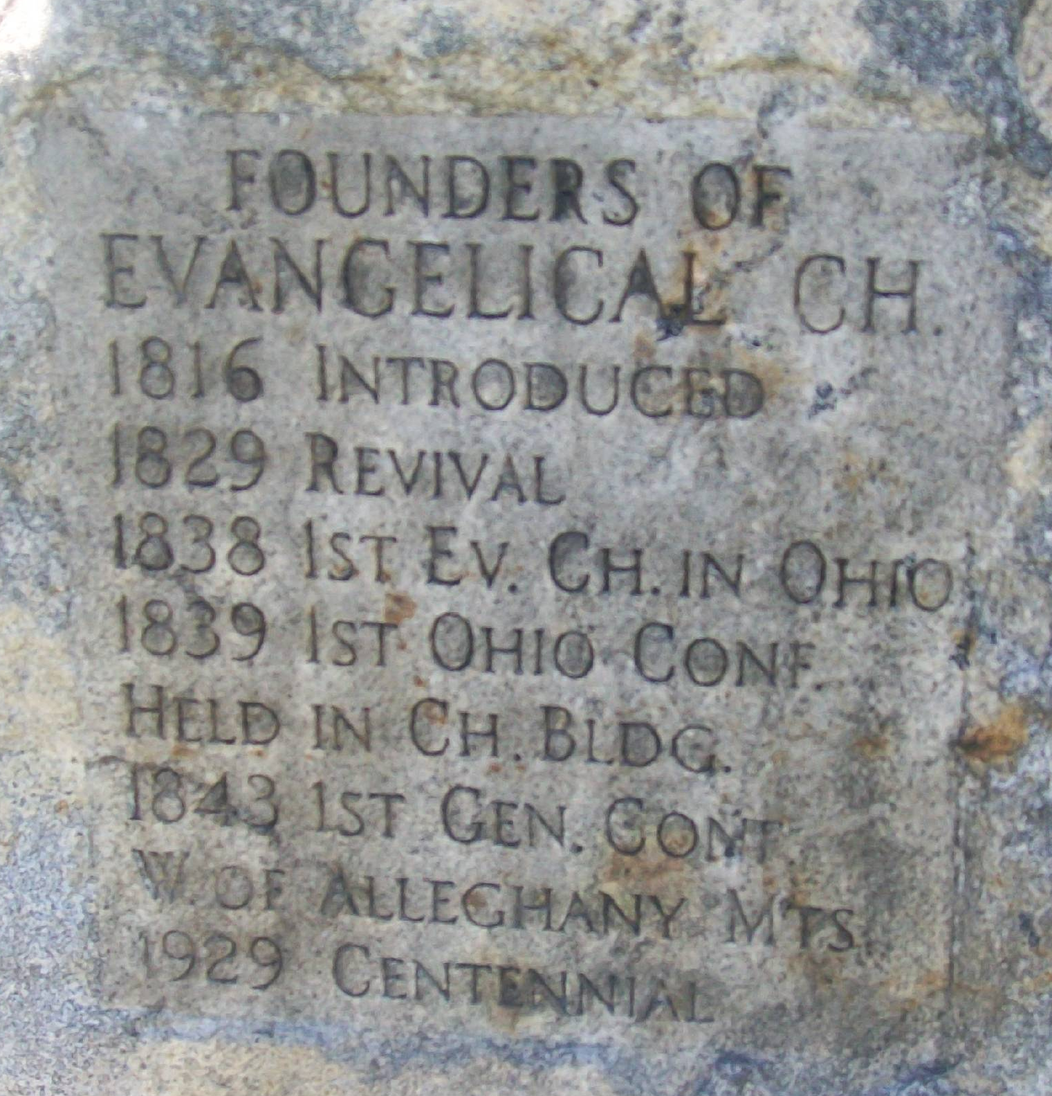

Documentation of Architectural Significance
Notes:
As previously described, the marker stone shown above was placed at the location of the First Evangelical Church by the Evangelical Association during their Centennial Celebration in 1929. The marker lists the dates and events of significance for the Evangelical Association. The stone marker is the only lasting monument to the First Evangelical Church in Ohio.

Slide 20
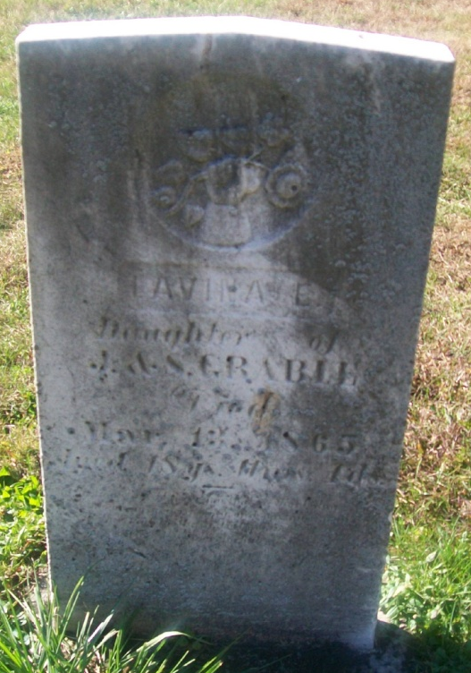
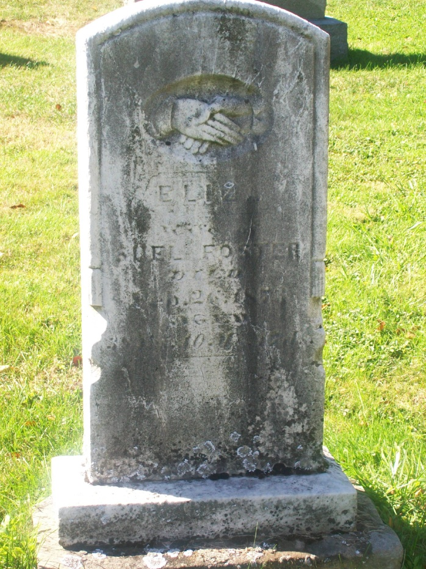
Documentation of Architectural Significance – Gravestone Art
The gravestone art found in the Greensburg Cemetery reflects the Pennsylvania German heritage of the early settlers of Green and the religious beliefs of the Evangelicals in the 1800s.
Notes:
The gravestone art found in the Greensburg Cemetery reflects the Pennsylvania German heritage of the early settlers of Green and the religious beliefs of the Evangelicals in the 1800s.
Many early stones in Greensburg Cemetery are inscribed with an upward pointing hand. On some stones, a flower (usually a rose) is present behind the upward pointing hand.
According to An A to Z Guide to Cemetery Icons by ISIS Publications, 2004-08, upward pointing hands signifies the hand of righteousness (citing Weeden). It also suggests the pathway or ascension and the elevated realms of heaven.
Many of the gravestones also depict shaking hands. Shaking hands are common among married couples; indicating marriage, or farewell.
Many other artist stones representing the beliefs and styles contemporary to the time of the burial can be found in Greensburg Cemetery.

Slide 21
Time Period of Significance
The time period of significance is at least 1838 through 1938. The time period begins with the construction of the meeting house (church) and first burials and continues through the time of the last burials of our early settlers and veterans and their descendants.
Notes:
The time period of significance is at least 1838 through 1938. The time period begins with the construction of the meeting house (church) and first burials and continues through the time of the last burials of our early settlers and veterans and their descendants.

Slide 22
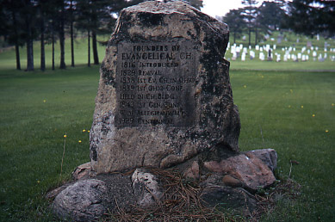
Greensburg Cemetery c. 1838
Notes:
This concludes our presentation on Greensburg Cemetery. Are there any questions?
When questions are finished, turn floor over to Sarah Haring for Staff Recommendation & Comments.

Slide 23
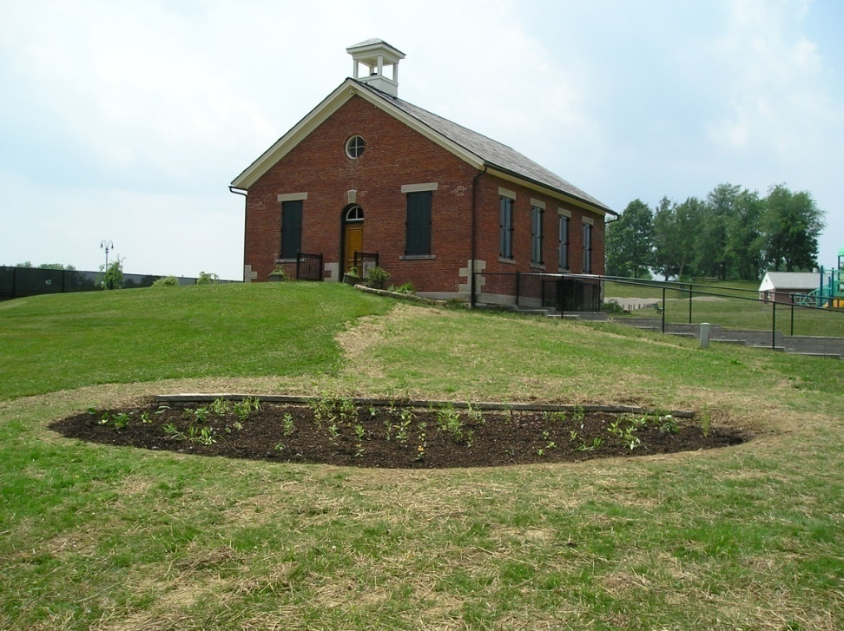
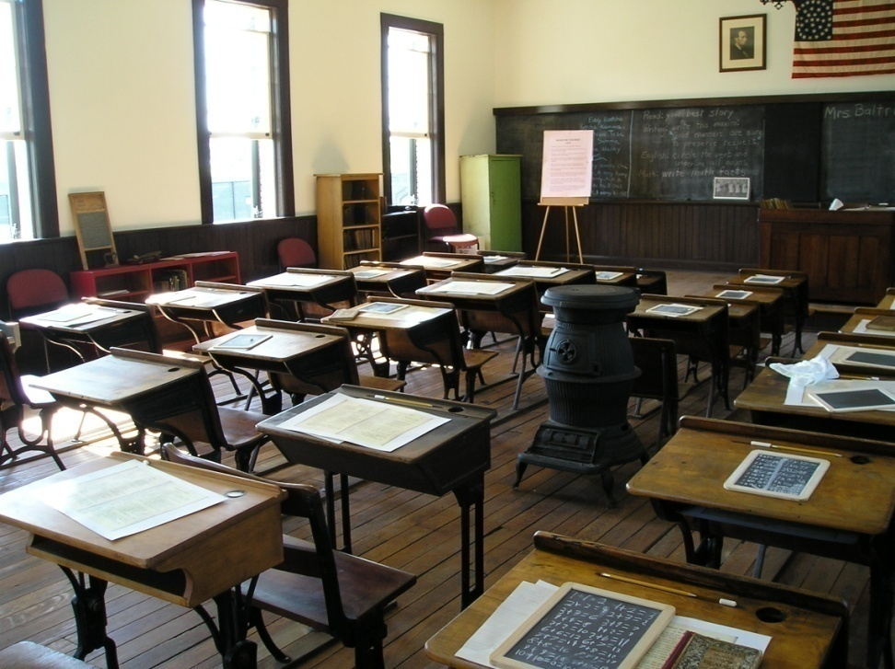
City of Green Local Landmarks
Lichtenwalter Schoolhouse - 1885
Notes:
Lichtenwalter Schoolhouse - 1885

Slide 24
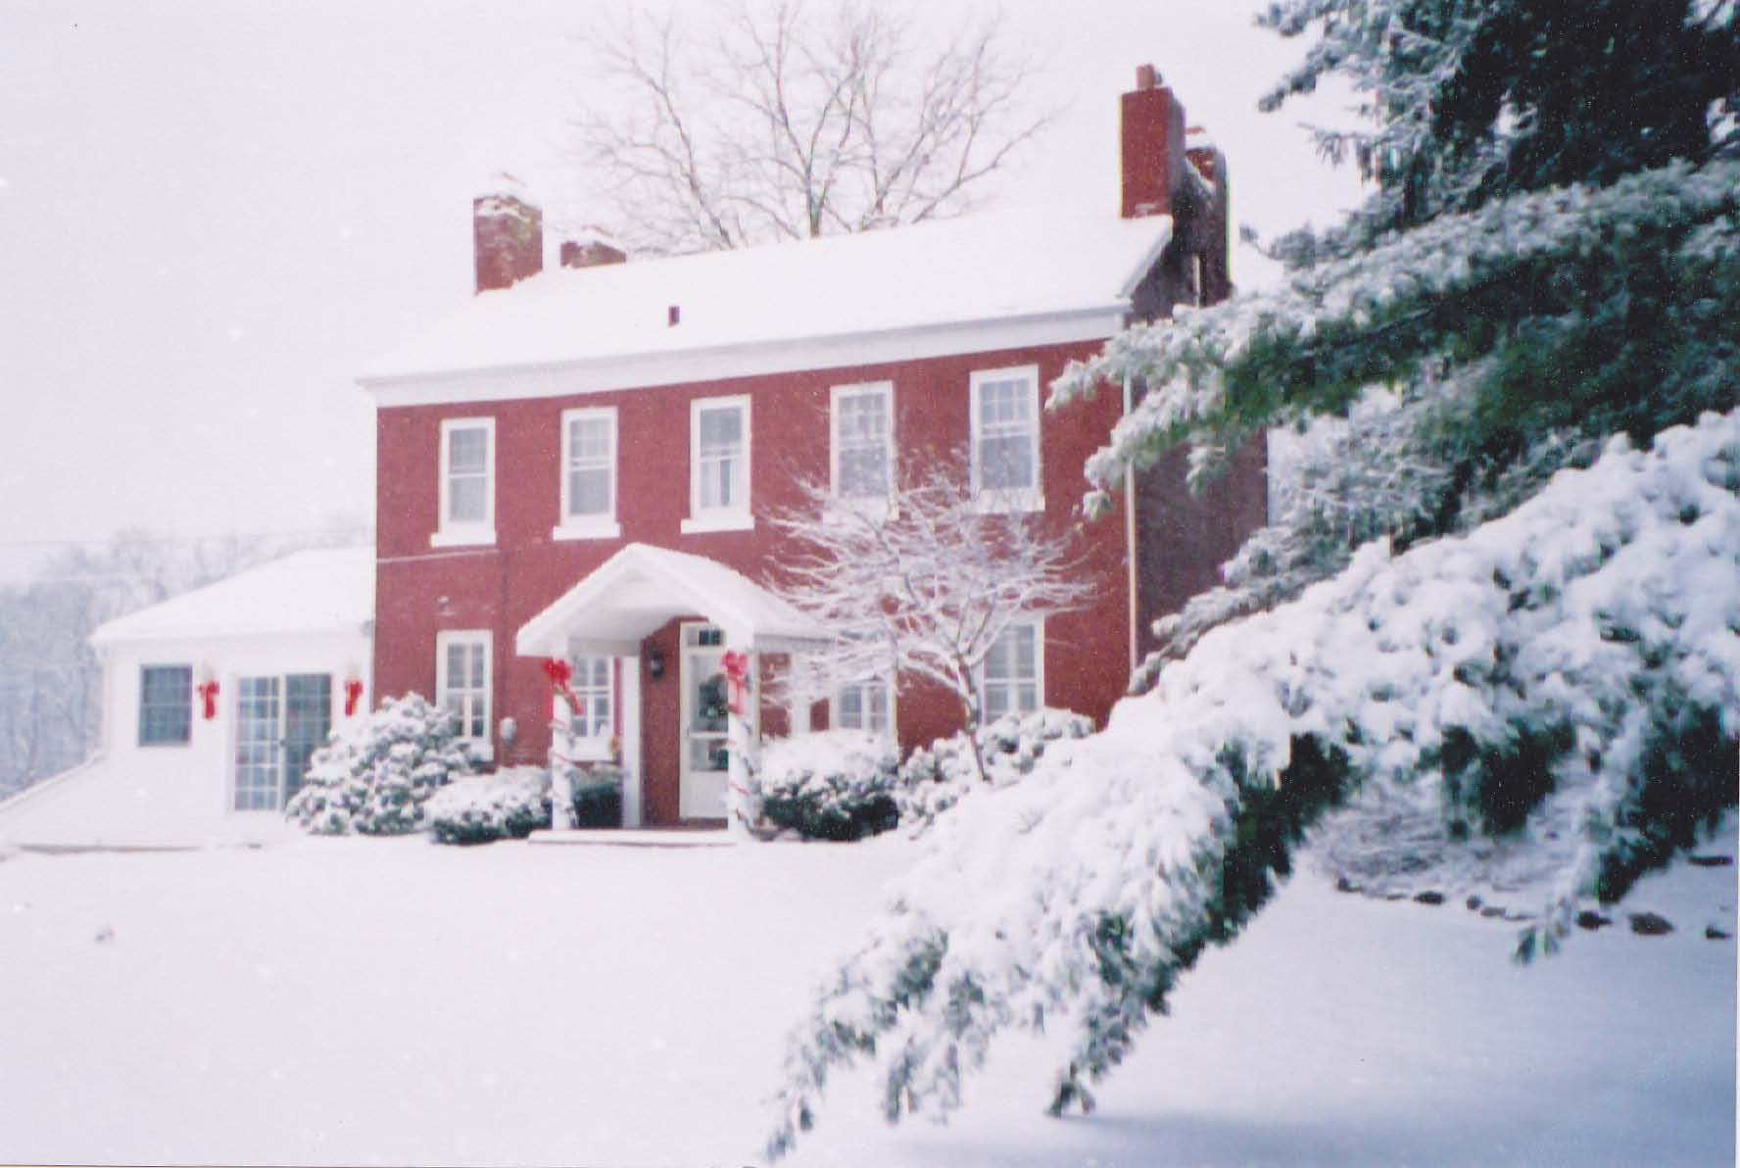
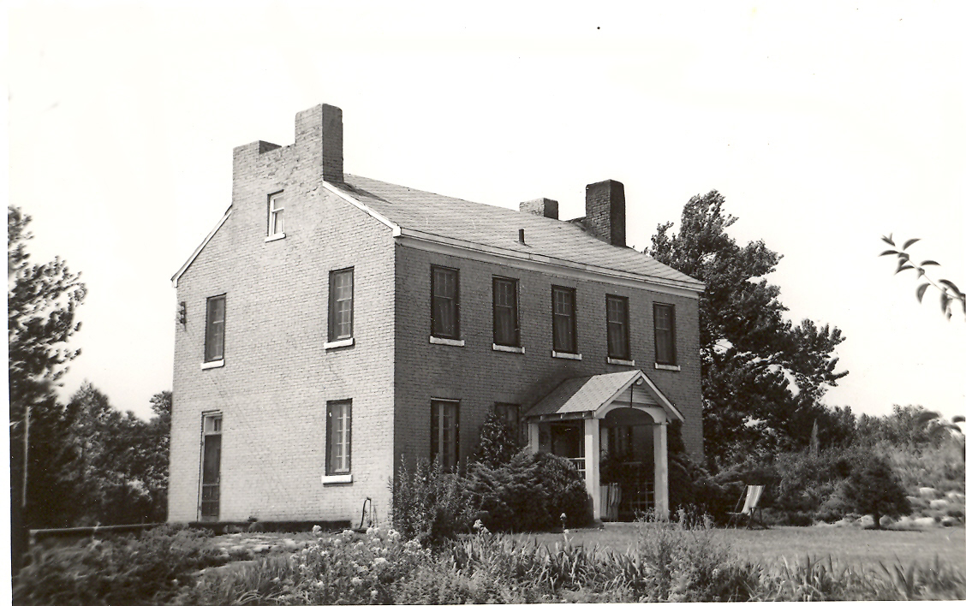
City of Green Local Landmarks
Conrad Dillman Home - 1832
Notes:
Conrad Dillman Home - 1832

Slide 25
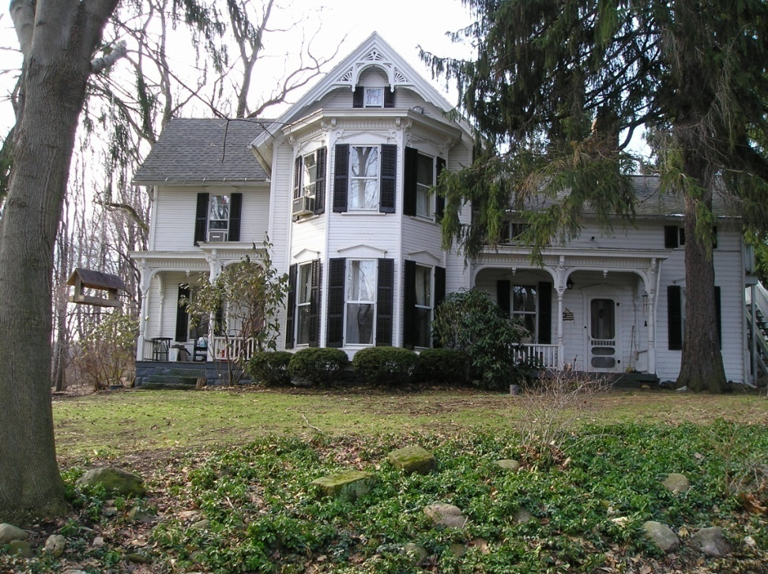
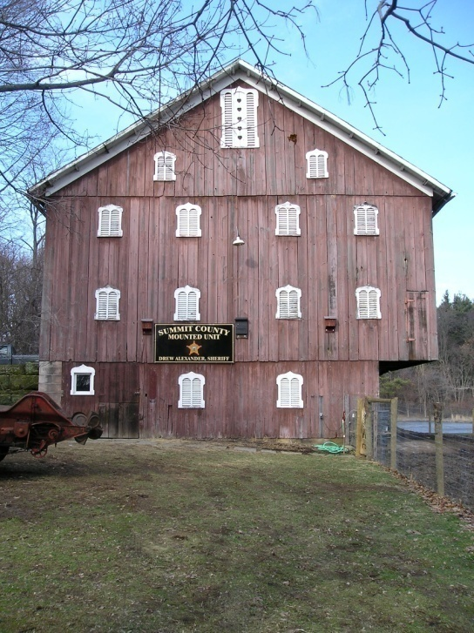
City of Green Local Landmarks
Southgate Farm – Hartong Farm c. 1883
Notes:
Southgate Farm – c. 1883

Slide 26
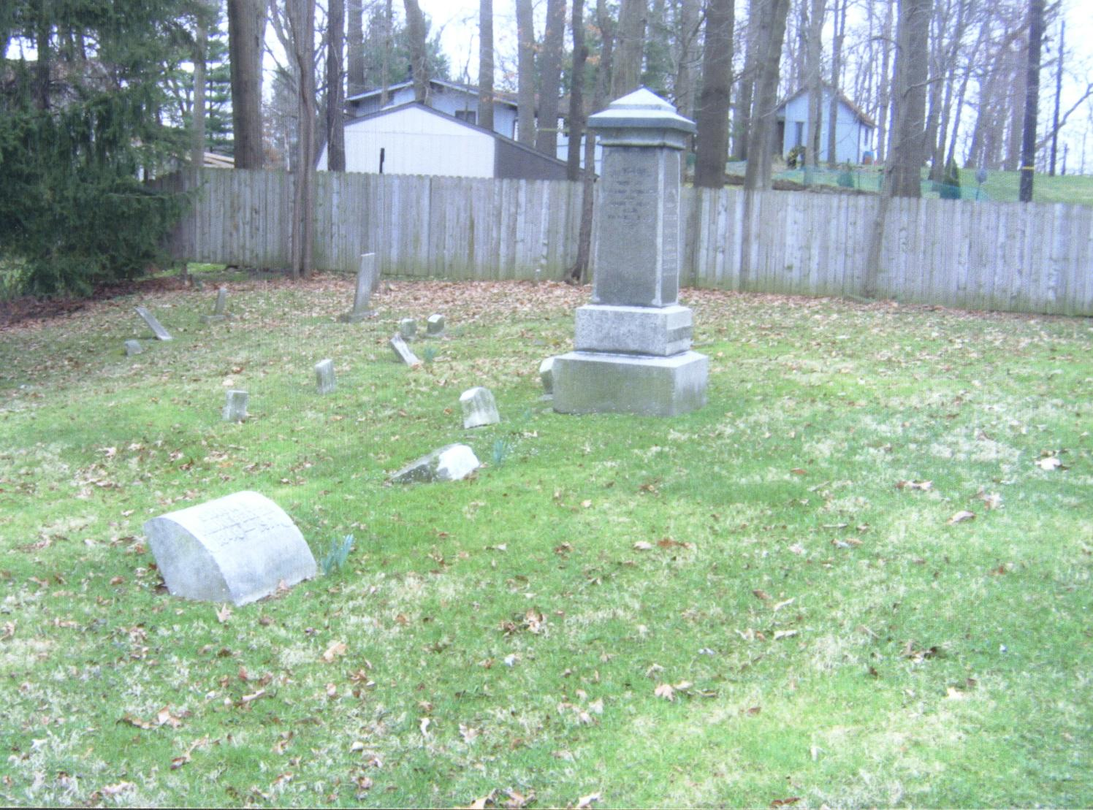
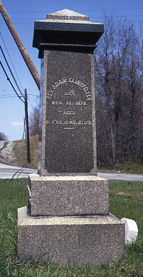
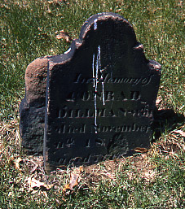
City of Green Local Landmarks
Klinefelter Cemetery – c. 1820
Notes:
Klinefelter Cemetery – c. 1820

Slide 27
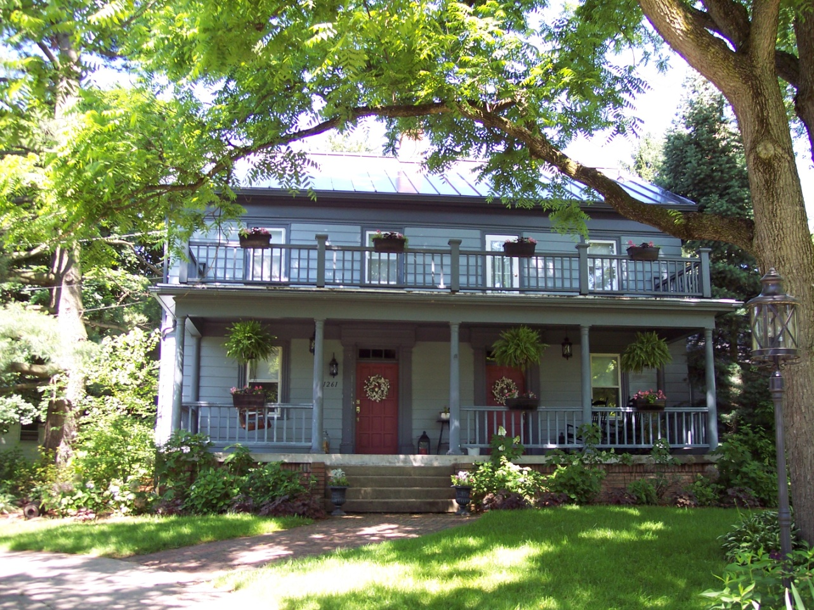
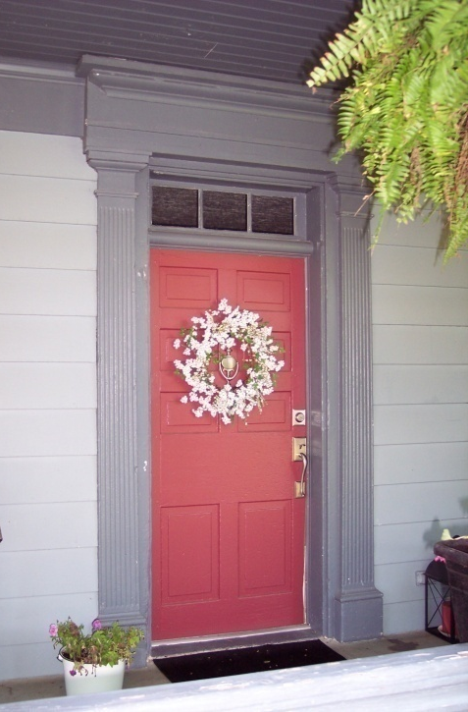
City of Green Local Landmarks
Rev. Henry Heiss Home – c. 1850
Notes:
Rev. Henry Heiss Home – c. 1850

Slide 28
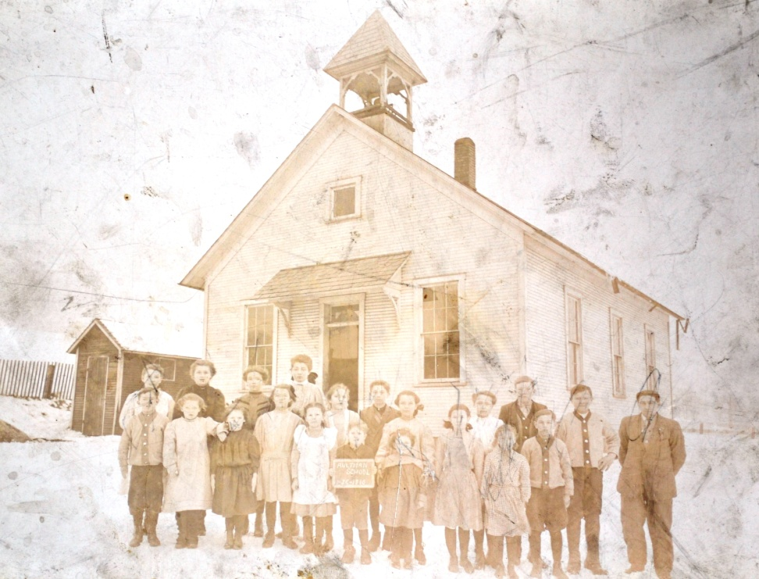
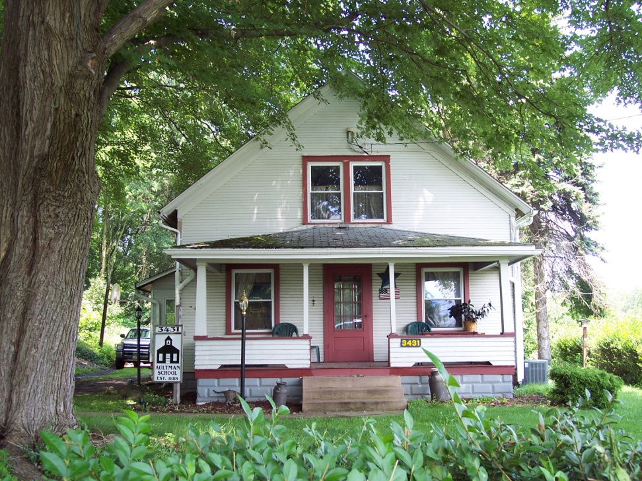
City of Green Local Landmarks
Aultman Schoolhouse – c. 1885
Notes:
Aultman Schoolhouse c. 1885

Slide 29
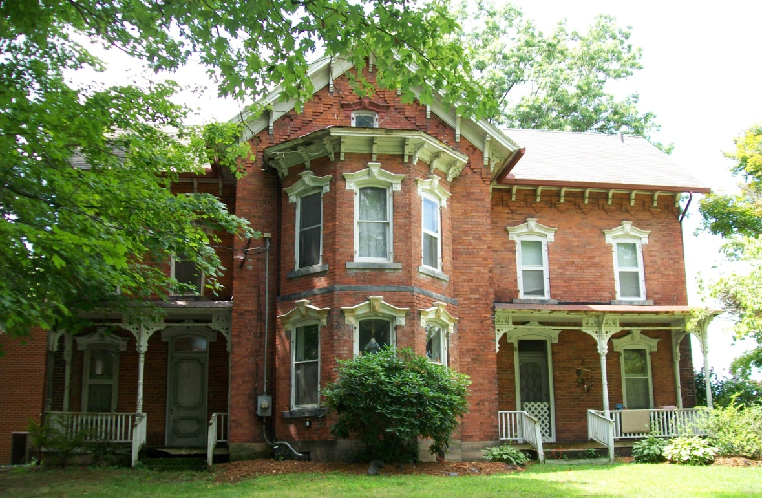
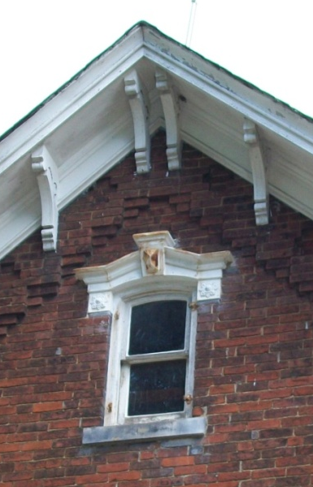

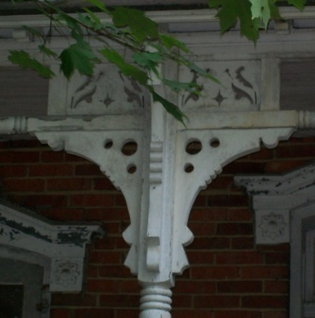
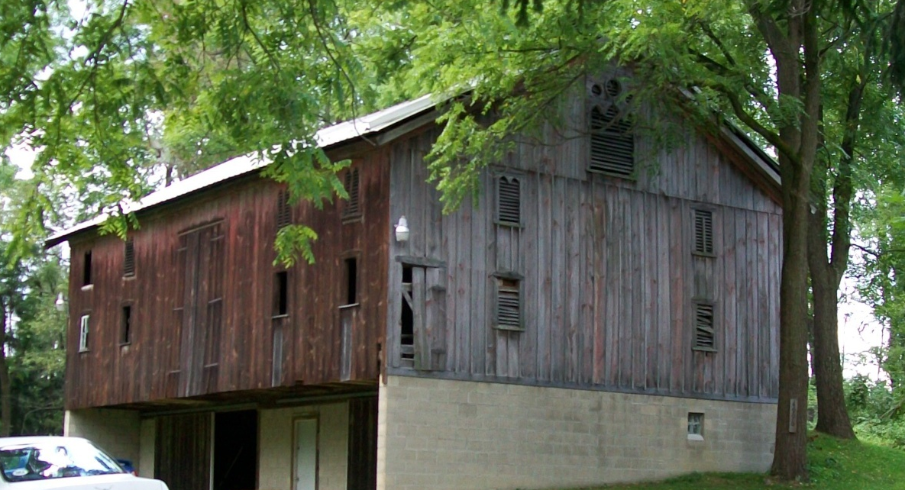
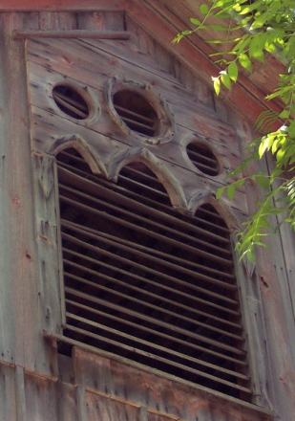
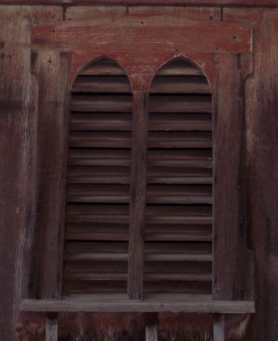
City of Green Local Landmarks
Aaron Swartz Home – c. 1882
Notes:
Aaron Swartz Home c. 1882

